Slide 1
Topic: Measurement
EQ: How do I find the perimeter of an object?
Get your VIVO’s

Slide 2
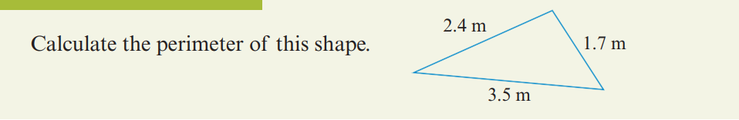
24
7
30
Topic: Measurement
EQ: How do I find the perimeter of an object?
Perimeter is the ___________ around the ________ edge of a _____________shape.
Since perimeter is a ________ measurement, common units are _____, _____, m and km.
To calculate the perimeter, _________ the ____________ of each _________ together.
All length measurements must be in the ____________ unit before being added
Notes:
Perimeter is the distance around the outside edge of a two-dimensional (2D) shape. Since perimeter is a length measurement, common units are millimetres, centimetres, metres and kilometres. To calculate the perimeter, add the length of each side together. All length measurements must be in the same unit before being added.
Also students need to be adding in the questions as part of 24:7:30 revision

Slide 3
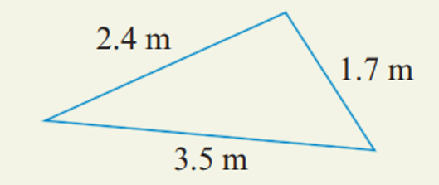
24
7
30
Topic: Measurement
EQ: How do I find the perimeter of an object?
Example 1: Calculate the perimeter of this shape:
Notes:
perimeter = 1.7 m + 2.4 m + 3.5 m

Slide 4
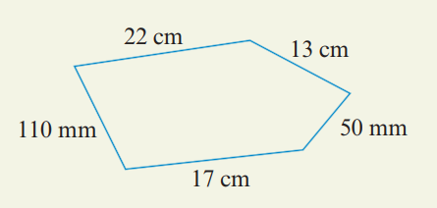
24
7
30
Topic: Measurement
EQ: How do I find the perimeter of an object?
Example 2: Calculate the perimeter of this shape:
Notes:
Check whether all the measurements are shown in the same unit (no).
Express them in centimetres. = 22 cm + 13 cm + 5 cm + 17 cm + 11 cm
Add all the lengths together and include the appropriate unit. = 68 cm

Slide 5
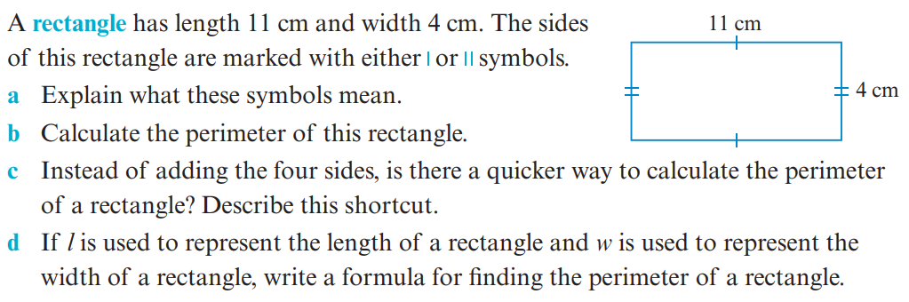
24
7
30
Topic: Measurement
EQ: How do I find the perimeter of an object?
Example 3:

Slide 6
24
7
30
Topic: Measurement
EQ: How do I find the perimeter of an object?
Your turn:
Complete the worksheets with 3 questions- Ensure you show full working out
Complete Exit Pass

